Slide 2
The __str__ method
Object’s state: the values of the object’s attribute at a given moment
__str__ method: displays the object’s state
  Automatically called when the object is passed as an argument to the print function
  Automatically called when the object is passed as an argument to the str function

Slide 3
The __str__ method
def __str__(self):
    return 'The balance is $' + format(self.__balance, ',.2f’)
# Create a BankAccount object
savings = BankAccountClass.BankAccount(start_bal)
# Display the balance
print(savings)
#Alternate way to display calling the str method
message = str(savings)
print(message)

Slide 4
Accessor and Mutator Methods
Typically, all of a class’s data attributes are private and provide methods to access and change them
Accessor methods: return a value from a class’s attribute without changing it
  Safe way for code outside the class to retrieve the value of attributes
Mutator methods: store or change the value of a data attribute

Slide 5
Working With Instances
Instance attribute: belongs to a specific instance of a class
  Created when a method uses the self parameter to create an attribute
If many instances of a class are created, each would have its own set of attributes

Slide 6
Working With Instances
def main():
# Create three objects from the Coin class.
coin1 = coin.Coin()
coin2 = coin.Coin()
coin3 = coin.Coin()

Slide 7
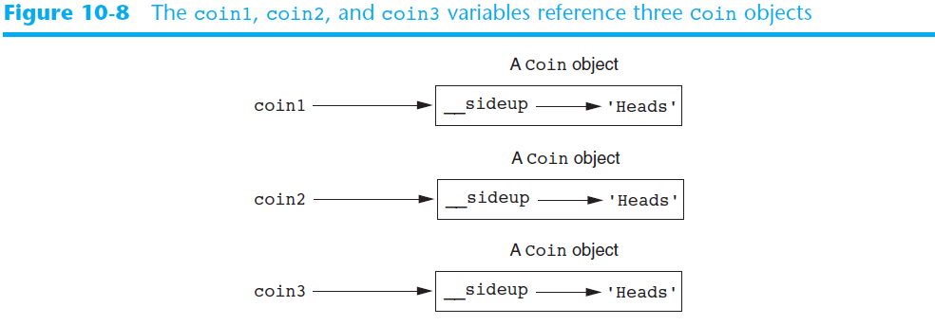
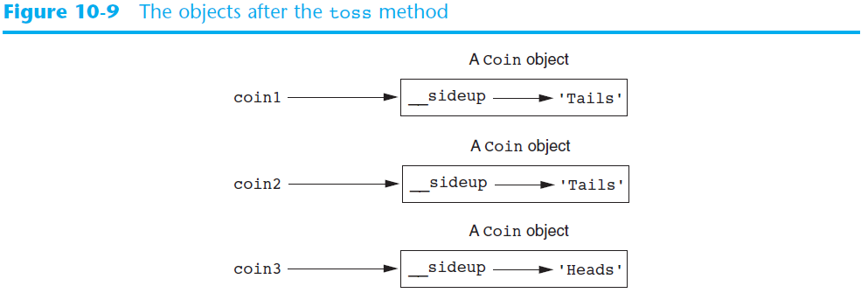

Slide 8
Passing Objects as Arguments
Methods and functions often need to accept objects as arguments
When you pass an object as an argument, you are actually passing a reference to the object
  The receiving method or function has access to the actual object
    Methods of the object can be called within the receiving function or method, and data attributes may be changed using mutator methods

Slide 9
Passing Objects as Arguments
# define a function that calls the get_sideup() method of the
# coin object
def show_coin_status(coin_obj):
print('This side of the coin is up:', coin_obj.get_sideup())
# define a function that calls the toss() method of the
# coin object
def flip(coin_obj):
coin_obj.toss()
my_coin = coin.Coin() # create an instance of the coin object
show_coin_status(my_coin) # call the show_coin_status function
flip(my_coin) # call the flip function

Slide 10
Techniques for Designing Classes
UML diagram: standard diagrams for graphically depicting object-oriented systems
  Stands for Unified Modeling Language
General layout: box divided into three sections:
  Top section: name of the class
  Middle section: list of data attributes
  Bottom section: list of class methods

Slide 11
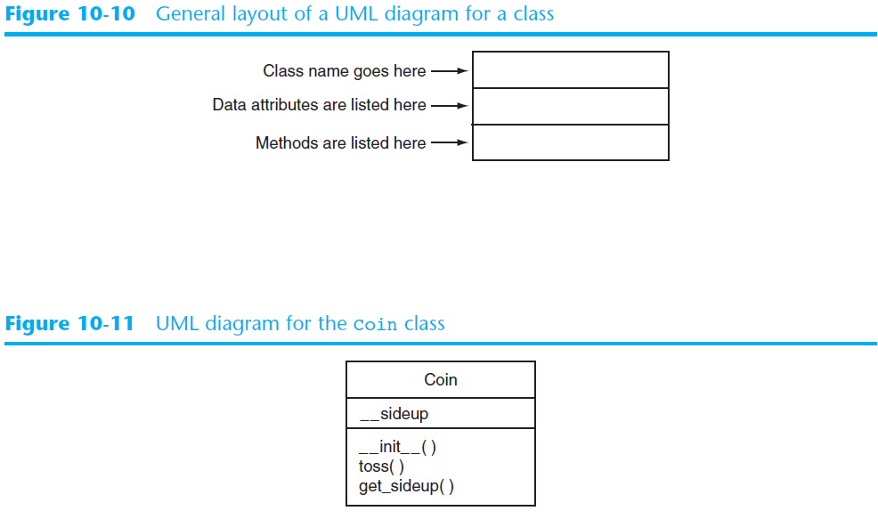

Slide 12
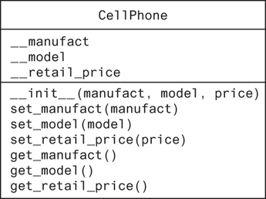
UML of CellPhone Class

Slide 13
Joe’s Automotive Shop
Joe’s Automotive Shop services foreign cars and specializes in servicing cars made by Mercedes, Porsche, and BMW. When a customer brings a car to the shop, the manager gets the customer’s name, address, and telephone number. The manager then determines the make, model, and year of the car and gives the customer a service quote. The service quote shows the estimated parts charges, estimated labor charges, sales tax, and total estimated charges.

Slide 14
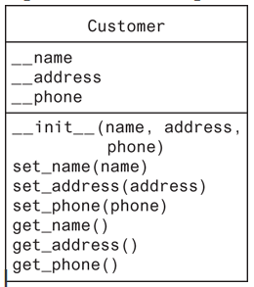
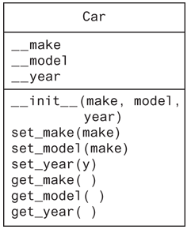
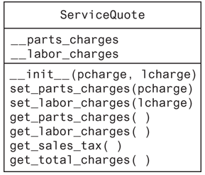
Create a class from a UML Diagram
Design a Python program for Joe’s Automotive Shop by using classes based on the UML diagrams below and the write-up from previous slide.

